Slide 1

Group 4
Hsing-Chen Chung
Yueh Tsao
Ying Wu
Peiyan Yu

Slide 2


http://35.225.144.4.xip.io/

Slide 3


Slide 4
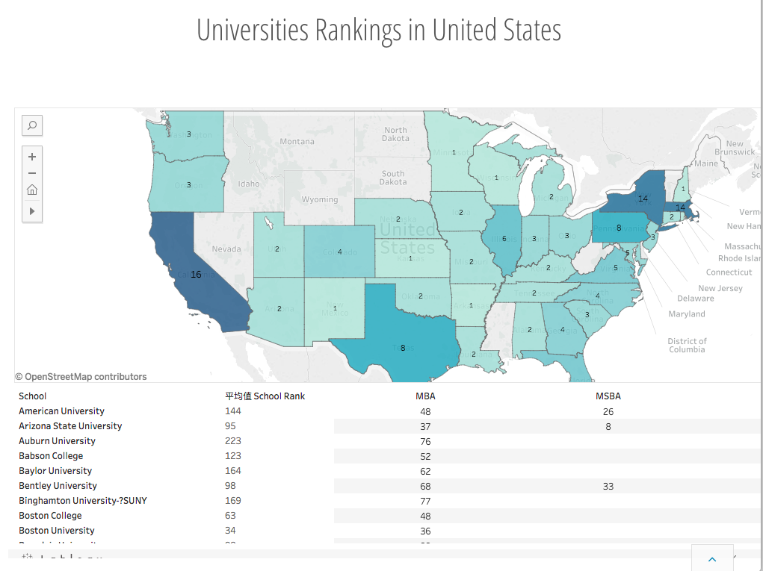

Slide 5
Outline: Database Design & Implementation process
Stage 1:
Plan&Analysis
1
Stage 3:
A. Implementation &
B. Application
3
Stage 2: Database Design
A. Conceptual Design
B. Logical Design
C. Physical Design
2

Slide 6

Stage 1: Plan & Analysis
Vision
User Identification
Mission Statement
Mission Objective

Slide 7
Mission Statement
Empowering you with comprehensive information to a fit master degree at your fingertips.

Slide 8
Mission Objective
To learn about details of cities where targeted schools are located
To find master programs in a targeted city.
To perform search on program and school details including type, tuition, length, size, and expected salary.
To compare school and program rankings from different systems.
To learn the trends of school and program rankings.
To find master programs in targeted schools.
To know the school where certain programs belong to.
To compare different programs easily through visualized graphs.

Slide 9

Stage 2 A: Conceptual Design
Entity
Relationship
Attribute
ER diagram
Degree
Constraints

Slide 10
ER Model
5
Entities
School
Program
City
SclRank
PrgRank
4
Relationships
SclIn
PrgBelongsTo
SclRankedAs
PrgRankedAs
some
Important
Attributes

Slide 11
Relationships, Degrees, Attributes, Constraints
SclIn: binary relationship (cty, sclId)
1 School to 1 City
1 City to 0 or more School
SclRankAs: binary relationship (sclRank)
1 category and 1 year to 1 or more schools
1 school to 0 or more categories and years
PrgRankAs: binary relationship (prgRank)
1 category and 1 year to 1 or more programs
1 programs to 0 or more categories and years
PrgBelongsTo: binary relationship (prgId, sclId)
1 school can have 1 or more programs
1 program belong to 1 school

Slide 12
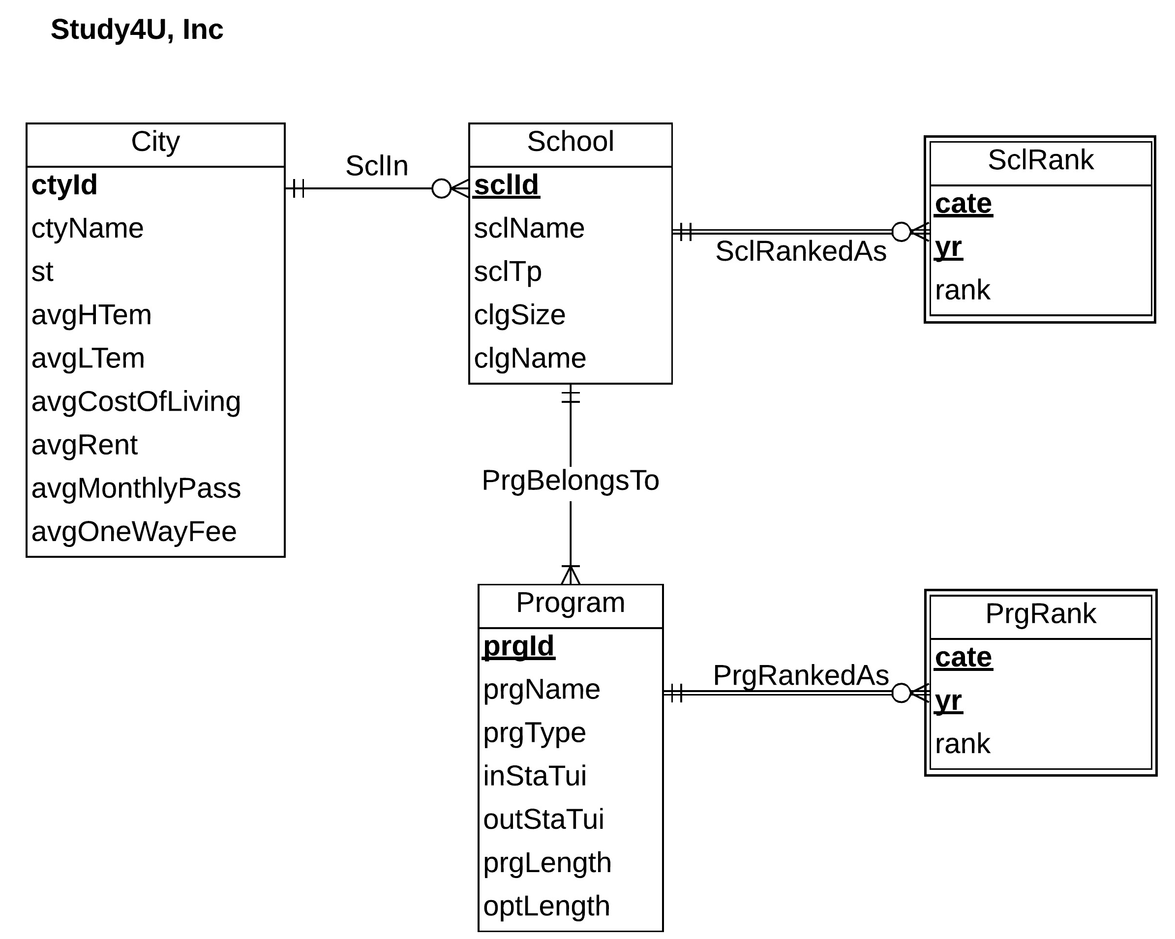
ER diagram

Slide 13

Stage 2 B: Logical Design
ER Schema
Relational Schema
Relations
Functional dependencies
Normalization to 3NF
Business Rules:
Referential integrity

Slide 14
Relational schema
Normalization to 3NF：
Program (prgId, prgName, prgType, sclId, inStaTui, outStaTui, prgLength, optLength)
School (sclId, sclName,ctyId, sclTp, clgName, clgSize,clgYears)
City (ctyId, ctyName, state, avgTem, avgRent, avgUtilities, avgTransportation)
SclRank (cate, yr, sclId, sclRank, colRank)
PrgRank (cate, yr, prgId, prgRank)

Slide 15

Stage 2 C: Physical Design
Store Format
Data type
Integrity Constraints

Slide 16
Physical Database Design
create table [Study4U_PrgRank](
cate VARCHAR(20) NOT NULL,
yr date NOT NULL,
prgRank INTEGER,
prgId VARCHAR(20) NOT NULL,
CONSTRAINT pk_PrgRankedAs_cate_yr_prgId PRIMARY KEY (cate,yr,prgId),
CONSTRAINT fk_PrgRankedAs_prgId FOREIGN KEY (prgId)
REFERENCES [Study4U_Program] (prgId)
ON DELETE NO ACTION ON UPDATE NO ACTION
);

Slide 17

Collect Data
Data manipulation for various information
SQL
Stage 3
A: Implementation

Slide 18
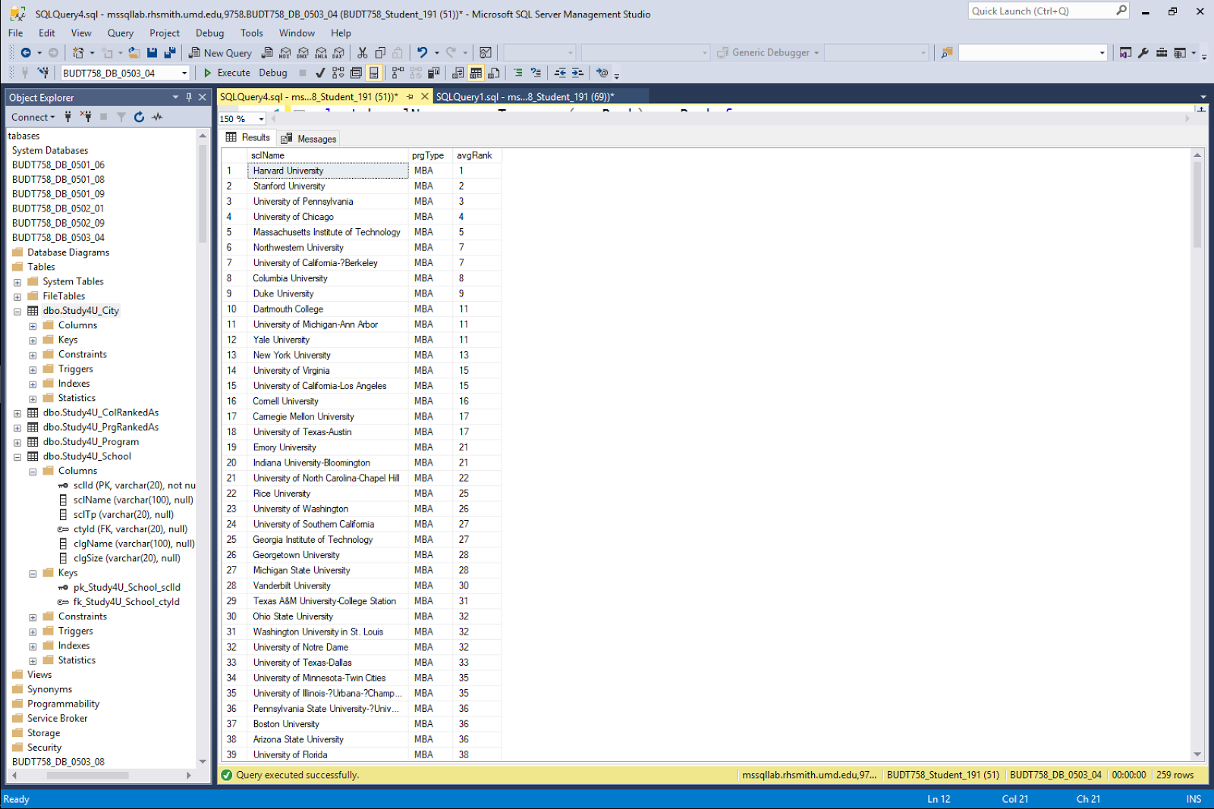
Business Transactions 1
What are the average rank of all rankings for each school?
select b.sclName,a.prgType,avg(prgRank) avgRank from
(select prgId,prgRank
from Study4U_PrgRank) as c
inner join
(select prgType,sclId,prgId from Study4U_Program) a
on c.prgId=a.prgId
inner join
(select sclName,sclId from Study4U_School) b
on a.sclId=b.sclId
group by b.sclName,a.prgType
order by prgType,avg(prgRank)

Slide 19
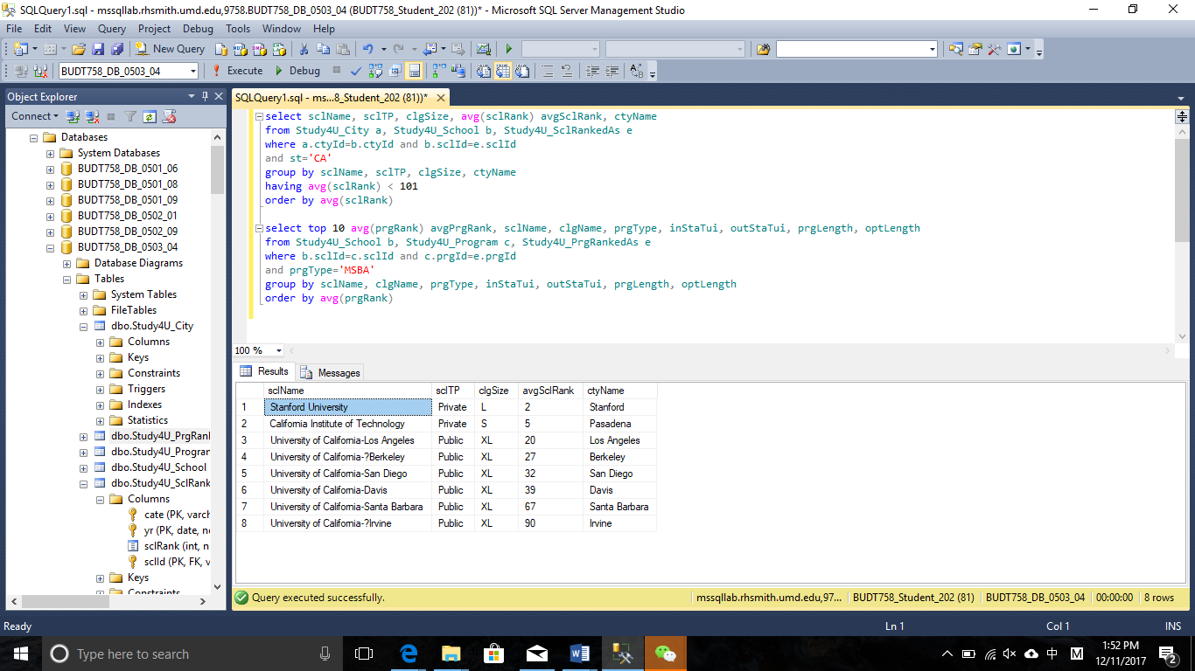
Business Transactions 2
What are the top 10 (average ranking) MSBA program along with it's details?
select top 10 avg(prgRank) avgPrgRank, sclName, clgName, prgType, inStaTui, outStaTui, prgLength, optLength
from Study4U_School b, Study4U_Program c, Study4U_PrgRankedAs e
where b.sclId=c.sclId and c.prgId=e.prgId
and prgType='MSBA'
group by sclName, clgName, prgType, inStaTui, outStaTui, prgLength, optLength
order by avg(prgRank)

Slide 20

Tableau
Embed into website
Transaction Example
Stage 3
B: Application

Slide 21

Homepage

Slide 22
Search schools in one area
CITY
Density Map
Filter by city features

Slide 23
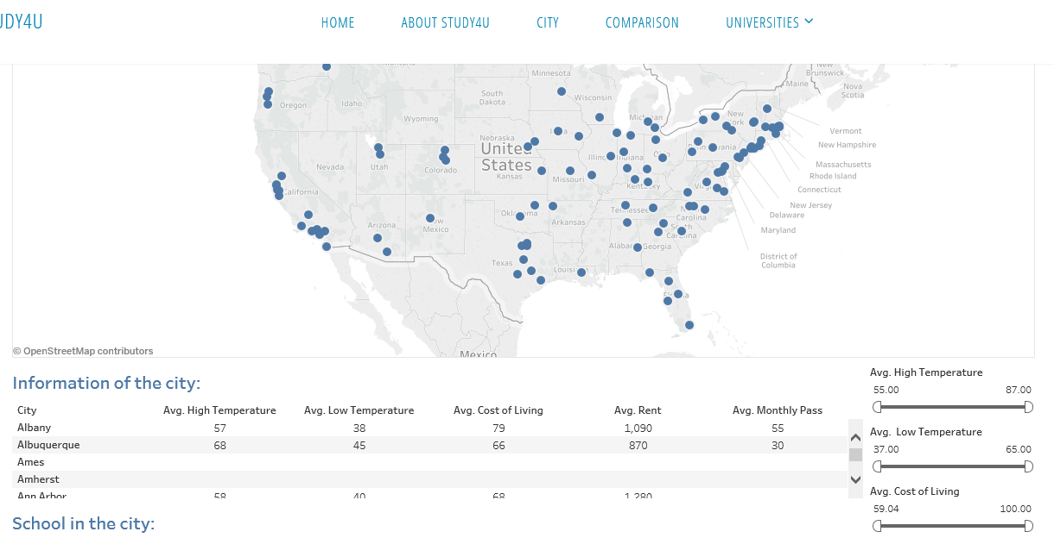
City Section
Example: A student wants to find school where cost of living is under $30 per day.
Feature
Filter

Slide 24
Calculated average rankings
RANKINGS
Filter & Detail
Ranking range filter
Direct searching tool

Slide 25
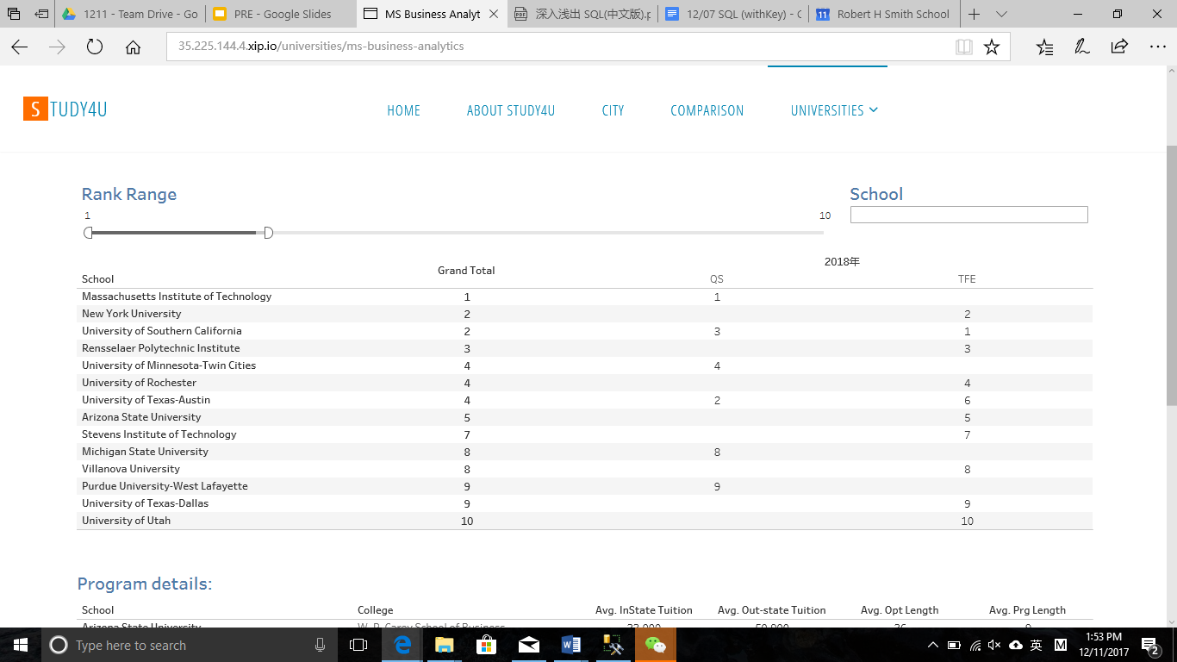
Rankings& Details Section
Example: A student’s expectation is top 10 MSBA programs. (in average ranking)
Range Filter
Search
Tool
Rankings

Slide 26
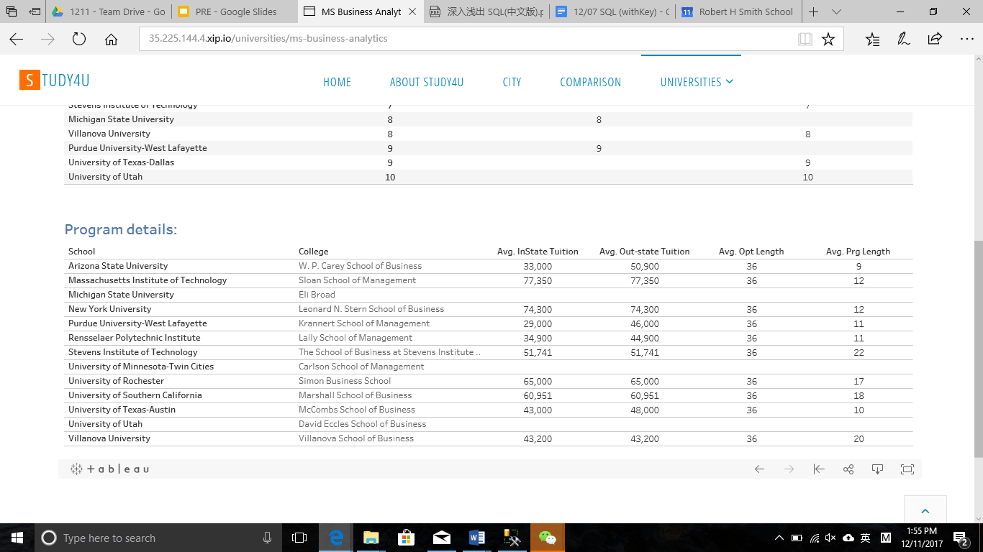
Rankings& Details Section
Example: Details of Top 10 schools.
Details

Slide 27
COMPARISON
Graph Presentation
Visualized comparison
Multiple selection

Slide 28
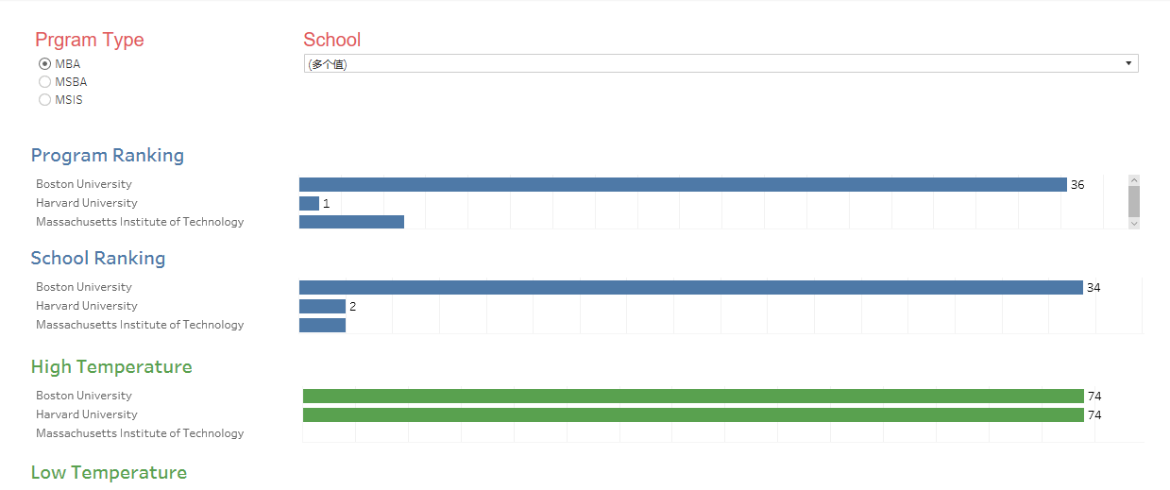
Comparison Section
Example: Compare information of Boston University, Harvard and MIT.
Choose program type and school

Slide 29
Q&A
Thanks for your watching!

